Slide 1
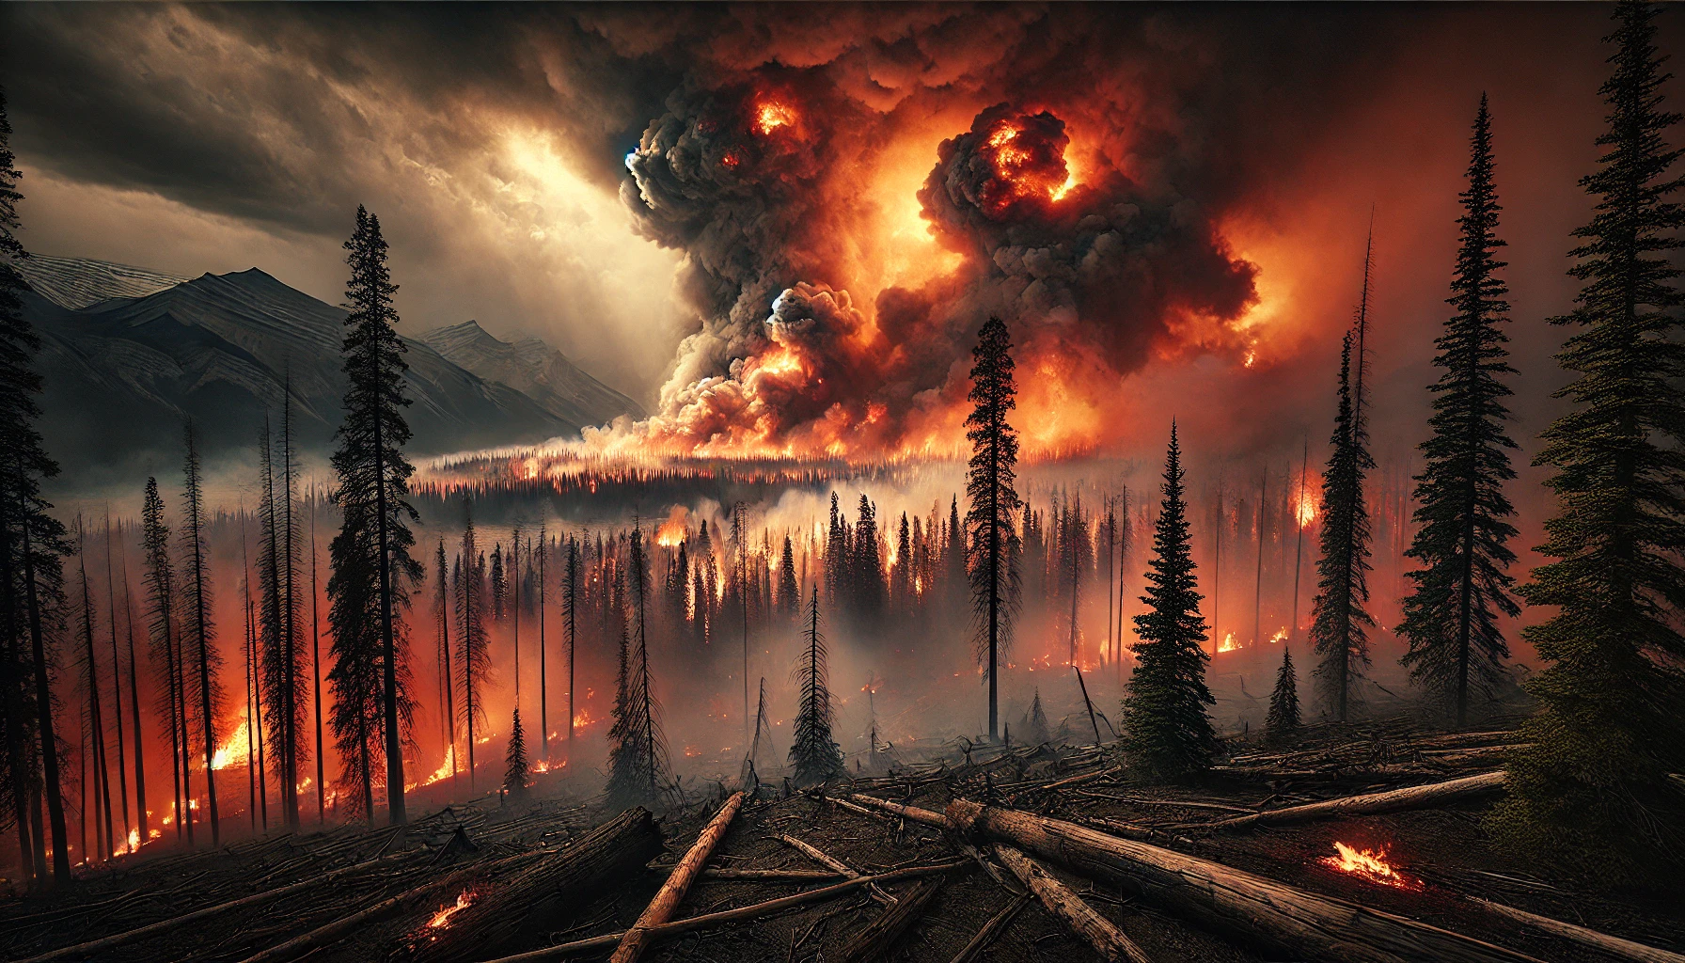
Applied ML Final Project
Initial Feasibility Report Presentation
Team Members

Slide 2
Agenda
Business Problem Statement
Responsible AI / Ethical Considerations
Project Goals
Data Context
Exploratory Data Analysis
Technical Approach
Conclusion & Next Steps

Slide 3

Business Problem Statement
Objective: Predict wildfire risks using ML models
Example: Jasper wildfire 2024 – Impact: $880 million loss
Potential savings from early detection: 10-20% of damages.

Slide 4
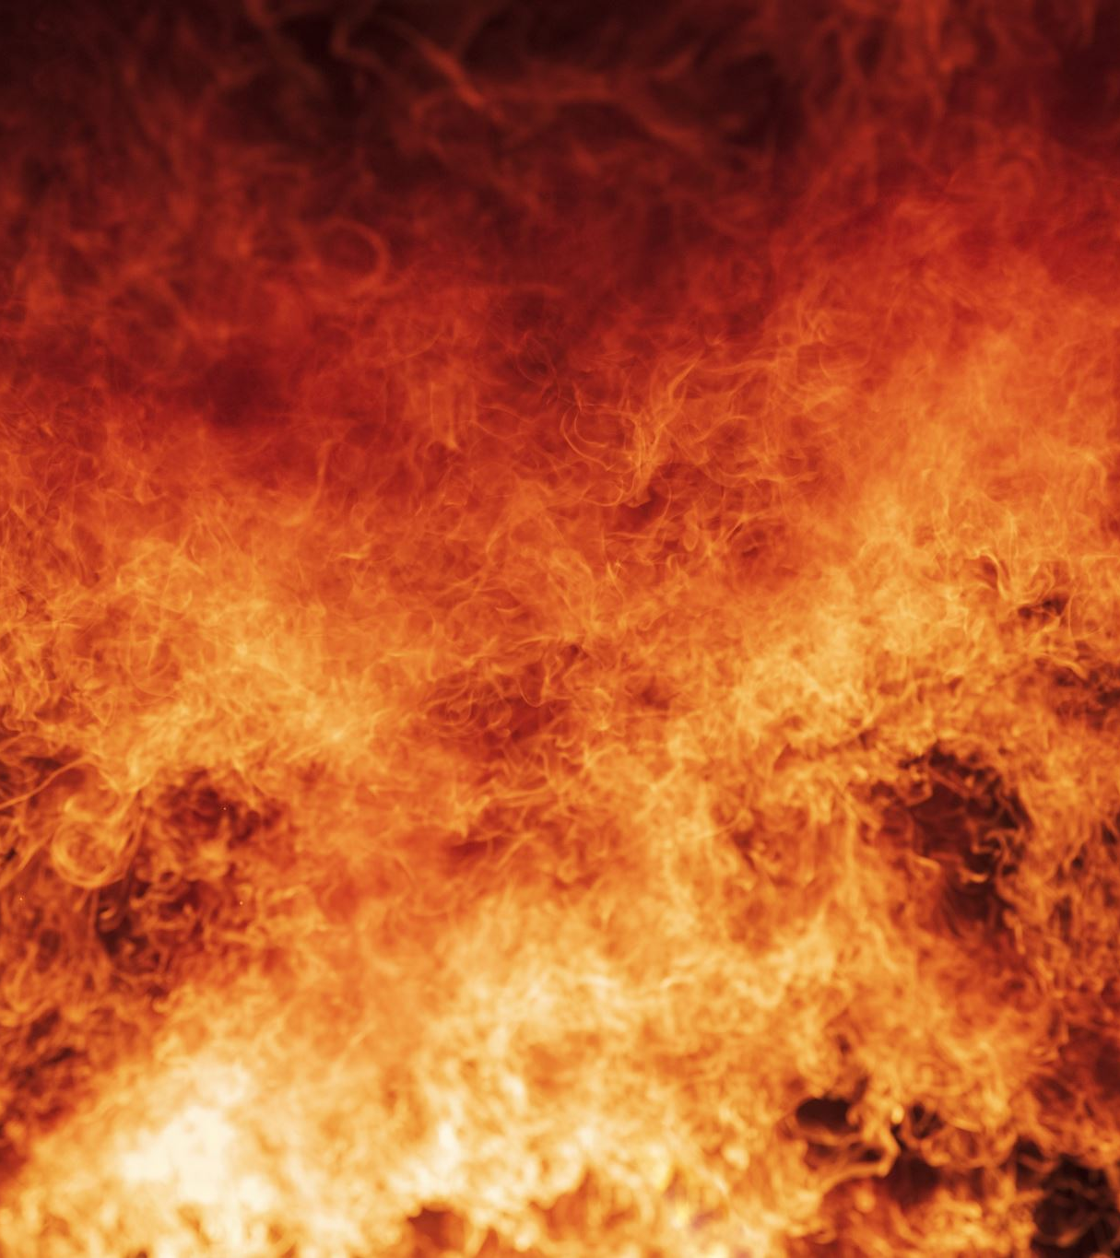
Why This Problem is Critical
Increasing frequency and severity of wildfires.
Societal, economic, and environmental impact.
Lack of early detection and prediction tools.

Slide 5

Responsible AI / Ethical Considerations
Bias in data (e.g., underrepresented regions)
Privacy and data security concerns.
Ethical considerations and mitigation strategies.

Slide 6

Project Goals
Goal 1: Predict wildfire risks.
Goal 2: Provide insights to emergency responders and policymakers.

Slide 7

Expected Benefits to Stakeholders
Government: Improved decision-making.
Insurance: Reduced claims.
Communities: Enhanced safety and preparedness.

Slide 8
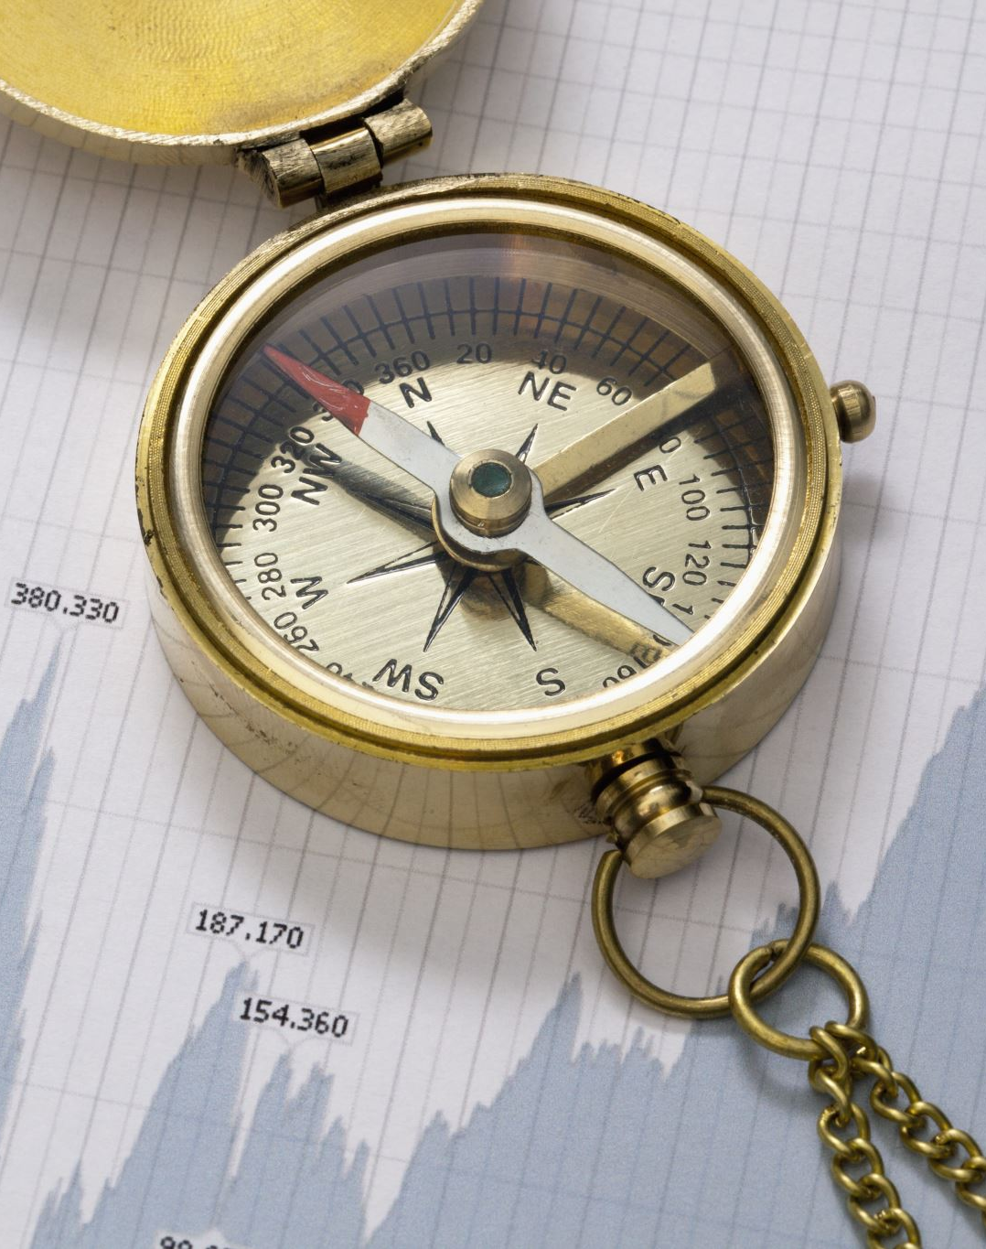
Data Context
Dataset 1: Wildfire historical data.
Dataset 2: Weather station data.
Data preprocessing challenges and justification for additional data.

Slide 9
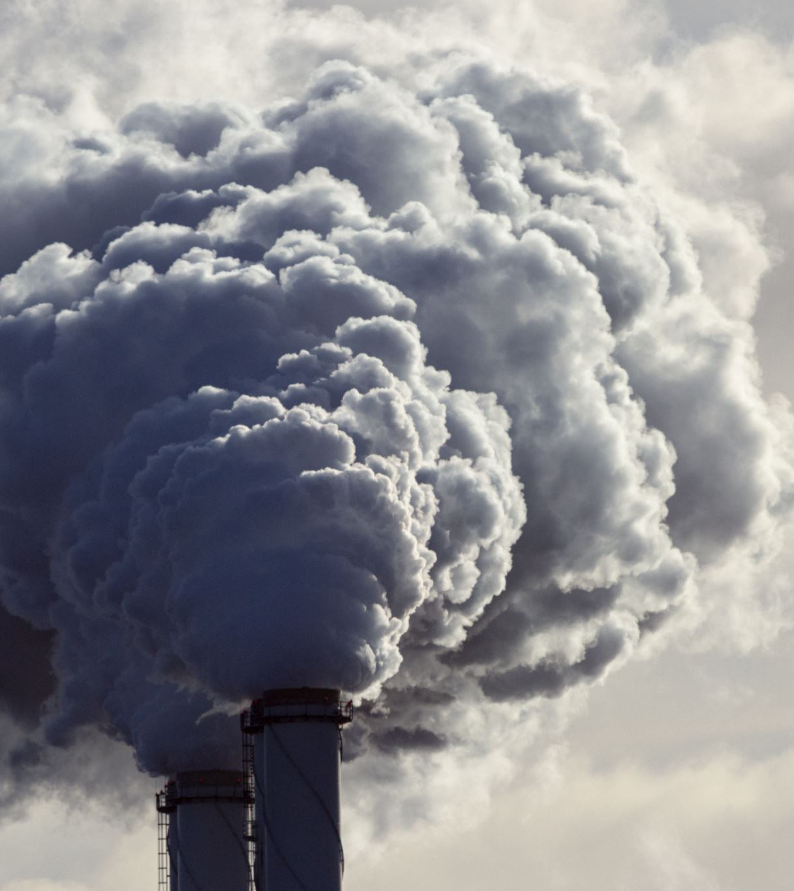
Overview of Datasets
Wildfire occurrences, weather readings, and environmental factors.

Slide 10

Exploratory Data Analysis (EDA)
Visualize trends in wildfire occurrences by year and region.
Correlation between weather conditions and fire sizes.

Slide 11
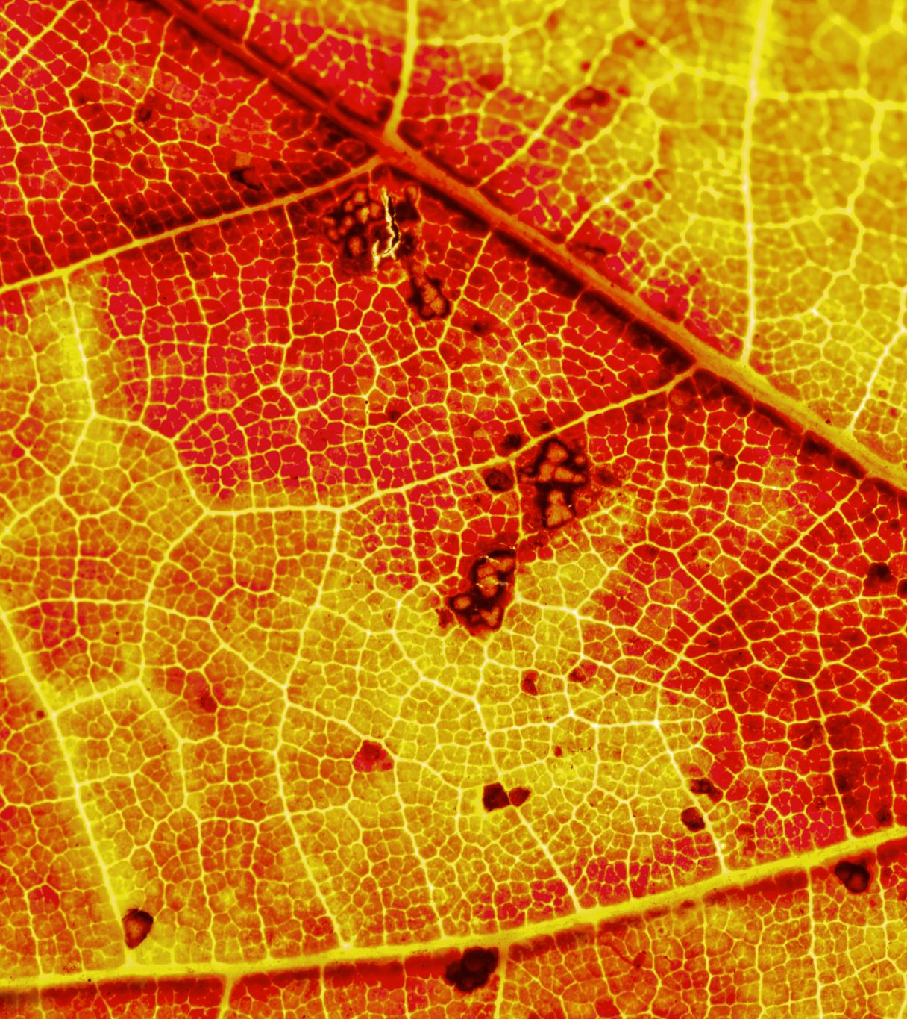
Key Insights from EDA
Patterns observed in wildfire occurrences.
Preliminary correlations between weather and fire size.

Slide 12

Proposed Technical Approach
Feature Engineering: Rolling averages, weather features.
Models: Random Forest, Gradient Boosting, Neural Networks.

Slide 13
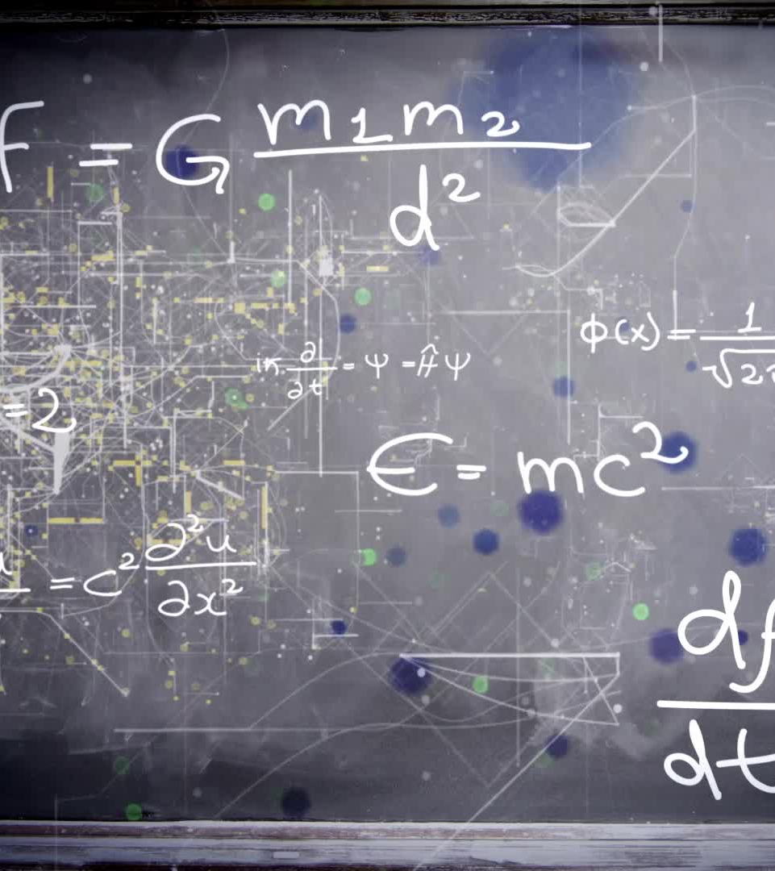
Feature Engineering
Example: 7-day rolling temperature averages.
Justification of feature choices.

Slide 14

Modeling Strategy
Baseline model: Linear regression.
Advanced models: Random Forest and Gradient Boosting.

Slide 15

Model Comparison
Performance comparison of different models.
Metrics: RMSE, MAPE.

Slide 16

Challenges in Data Modeling
Handling missing data.
Balancing the dataset for underrepresented regions or time periods.

Slide 17
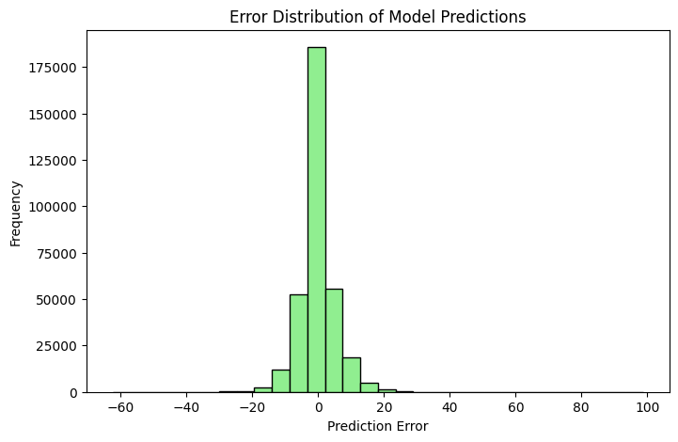
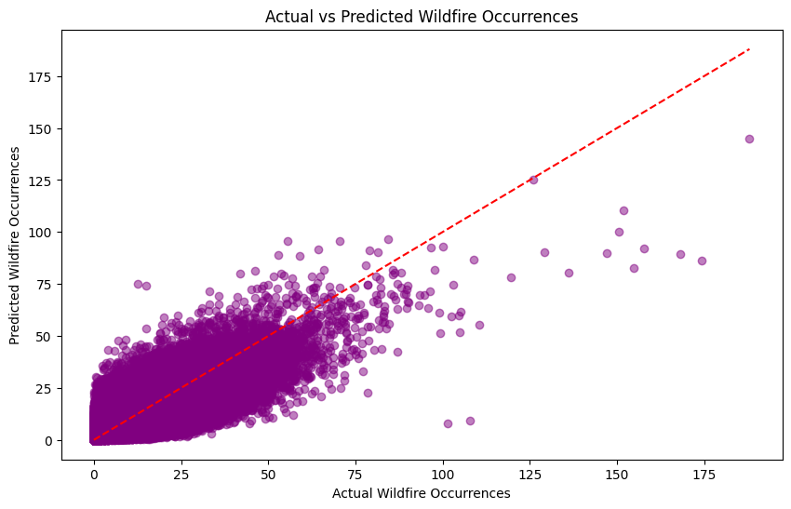
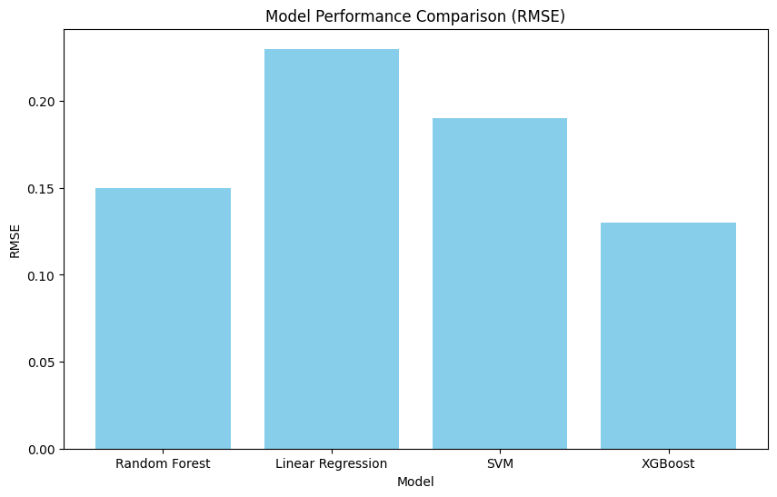
Model Performance and Prediction Accuracy

Slide 18
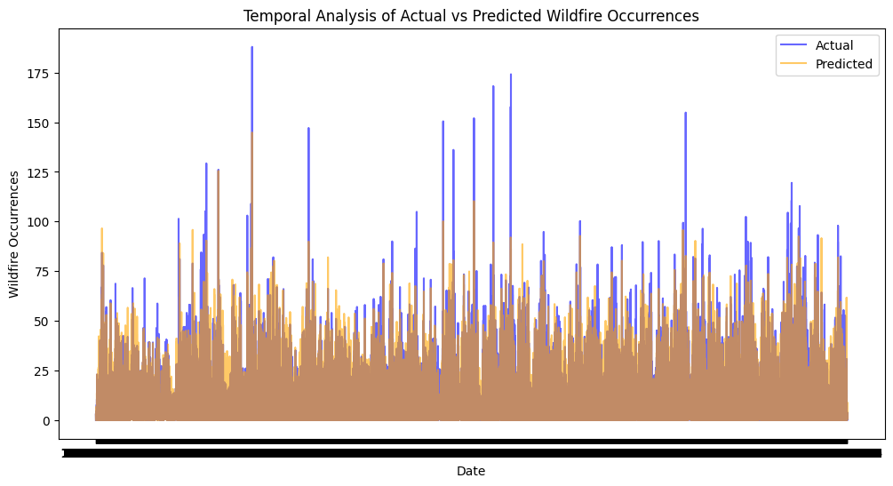
Temporal Analysis of Wildfire Predictions

Slide 19
Insights and Future Enhancements
Key Takeaways:Model performance shows strong alignment between predicted and actual wildfire occurrences, as depicted in the comparative scatter and temporal analysis graphs.Certain patterns in prediction errors suggest areas for further model refinement, particularly in high-frequency or high-severity instances.Areas for Improvement:Enhancing Model Accuracy: Further feature engineering and inclusion of additional environmental variables (e.g., humidity, vegetation density) could improve predictions.Reducing Prediction Variability: By implementing techniques like ensemble models (e.g., XGBoost), the model may achieve more consistent predictions across diverse regions and conditions.

Slide 20
Proposed Project Outcomes and Next Steps
Projected Impact: This project aims to support wildfire risk mitigation through insights for emergency responders and policy guidance.
Future Research: Plans include exploring additional data sources and testing advanced machine learning models.
Project Timeline: A structured timeline with key milestones will be established to guide project progress.
Anticipated Challenges: We expect to address data gaps and balance representation in the dataset.
Long-term Goals: Enhance community preparedness and contribute to sustainable wildfire management solutions.

Slide 21
Thank You

